Slide 1
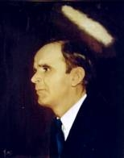

106
REACH OUT, TOUCH THE LORD
Reach out and touch the Lord as He passes by,
You’ll find He’s not too busy to hear your heart’s cry;
He’s passing by this moment, your needs to supply,
Reach out and touch the Lord as He goes by.

